Slide 1
Italian Sentiment Classification
Project by: Isaac Yeoh

Slide 2
Goal
To classify positive and negative Italian words using the Least Squares Method (Linear Regression)
Compare the results obtained from Linear Regression with other models
Observe how different models classify terms differently

Slide 3
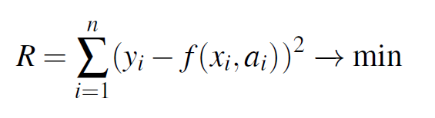
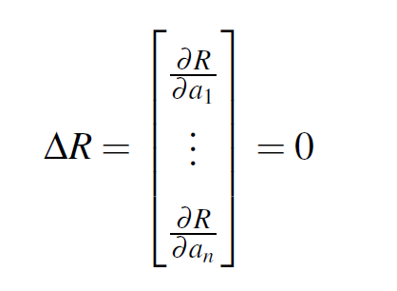
Refresher on Least Squares

Slide 4
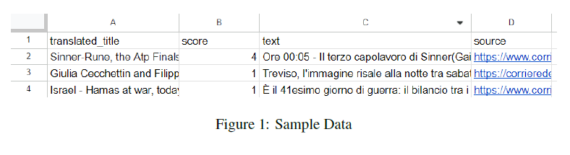
Data collection
Sourced Italian articles
Translated the title without translating the body
Gave it a score between 1-5
1 = bad
5 = good

Slide 5
Preprocessing
Mapped the scores ranging between 1 to 5 to a new sentiment score ranging between -2 to 2 for computation purposes
Removed numerals such as date/time
Removed Italian “stop” words
Common words such as “del” (of the), “suo” (his), “con” (with), etc.
Create a vector containing the tf-idf value of the words

Slide 6
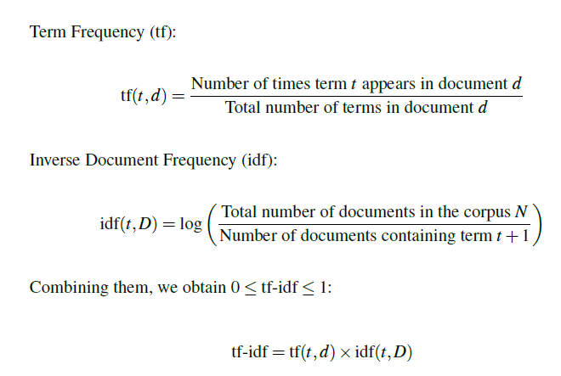
TF-IDF

Slide 7
Top 20 Negative Words (Linear Regression)
1. ’ragazzi’ (guys)
2. ’madre’ (mother)
3. ’morta’ (dead)
4. ’tre’ (three)
5. ’detto’ (said)
6. ’testa’ (head)
7. ’artificiale’ (artificial)
8. ’presidente’ (president)
9. ’figlia’ (daughter)
10. ’trovato’ (found)
11. ’foto’ (photo)
12. ’quattro’ (four)
13. ’autorit`a’ (authority)
14. ’denuncia’ (complaint)
15. ’gatto’ (cat)
16. ’punto’ (point)
17. ’persone’ (people)
18. ’modo’ (way)
19. ’ragazza’ (girl)
20. ’ormai’ (by now)

Slide 8
Top 20 Positive Words (Linear Regression)
1. ’nazionale’ (national)
2. ’grazie’ (thank you)
3. ’comitato’ (committee)
4. ’si’ (yes)
5. ’uno’ (one)
6. ’citt`a’ (city)
7. ’pace’ (peace)
8. ’quando’ (when)
9. ’infatti’ (indeed)
10. ’storia’ (story)
11. ’nuova’ (new)
12. ’stava’ (was)
13. ’ue’ (EU)
14. ’opere’ (works)
15. ’squadra’ (team)
16. ’sul’ (on the)
17. ’subito’ (immediately)
18. ’sindaco’ (mayor)
19. ’premio’ (prize)
20. ’ogni’ (every)

Slide 9
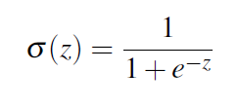
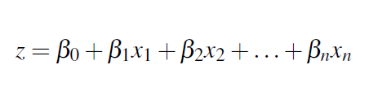
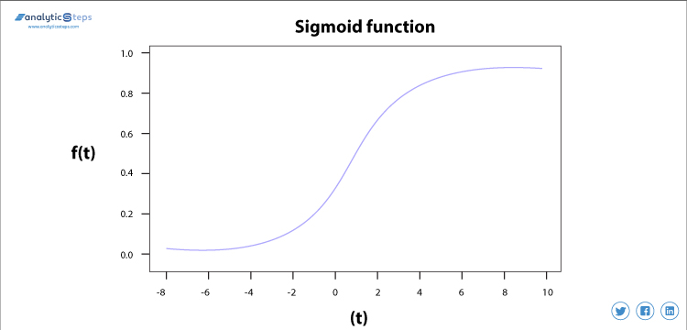
Logistic Regression
Another common model used to perform classification on sentiments
Dinesh Kumawat. 2019. “Introduction to Logistic Regression - Sigmoid Function, Code Explanation | Analytics Steps.” AnalyticsSteps. 2019. https://www.analyticssteps.com/blogs/introduction-logistic-regression-sigmoid-function-code-explanation.

Slide 10
Top 20 Negative Words (Logistic Regression)
Logistic
Linear
1. ’ragazzi’ (guys)
2. ’madre’ (mother)
3. ’morta’ (dead)
4. ’tre’ (three)
5. ’detto’ (said)
6. ’testa’ (head)
7. ’artificiale’ (artificial)
8. ’presidente’ (president)
9. ’figlia’ (daughter)
10. ’trovato’ (found)
11. ’foto’ (photo)
12. ’quattro’ (four)
13. ’autorit`a’ (authority)
14. ’denuncia’ (complaint)
15. ’gatto’ (cat)
16. ’punto’ (point)
17. ’persone’ (people)
18. ’modo’ (way)
19. ’ragazza’ (girl)
20. ’ormai’ (by now)
1. ’uccisione’ (killing)
2. ’morta’ (dead)
3. ’gaza’ (Gaza)
4. ’trovato’ (found)
5. ’testa’ (head)
6. ’turetta’ (turetta)
7. ’intelligenza’ (intelligence)
8. ’polizia’ (police)
9. ’netanyahu’ (Netanyahu)
10. ’hamas’ (Hamas)
11. ’cimitero’ (cemetery)
12. ’vienna’ (Vienna)
13. ’filippo’ (Filippo)
14. ’cani’ (dogs)
15. ’stevens’ (Stevens)
16. ’sparato’ (shot)
17. ’heather’ (Heather)
18. ’capretta’ (goat)
19. ’gatto’ (cat)
20. ’uomo’ (man)

Slide 11
Top 20 Positive Words (Logistic Regression)
Logistic
Linear
1. ’maggior’ (major)
2. ’moda’ (fashion)
3. ’rosa’ (pink)
4. ’nobel’ (Nobel)
5. ’mohammadi’ (Mohammadi)
6. ’francesco’ (Francesco)
7. ’lavoro’ (work)
8. ’mare’ (sea)
9. ’parte’ (part)
10. ’anno’ (year)
11. ’ue’ (EU)
12. ’storia’ (history)
13. ’europa’ (Europe)
14. ’lotto’ (lottery)
15. ’citt`a’ (city)
16. ’nazionale’ (national)
17. ’infatti’ (indeed)
18. ’contro’ (against)
19. ’tv’ (TV)
20. ’italia’ (Italy)
1. ’nazionale’ (national)
2. ’grazie’ (thank you)
3. ’comitato’ (committee)
4. ’si’ (yes)
5. ’uno’ (one)
6. ’citt`a’ (city)
7. ’pace’ (peace)
8. ’quando’ (when)
9. ’infatti’ (indeed)
10. ’storia’ (story)
11. ’nuova’ (new)
12. ’stava’ (was)
13. ’ue’ (EU)
14. ’opere’ (works)
15. ’squadra’ (team)
16. ’sul’ (on the)
17. ’subito’ (immediately)
18. ’sindaco’ (mayor)
19. ’premio’ (prize)
20. ’ogni’ (every)

Slide 12
No tf-idf model
Linear Regression, but no preprocessing tf-idf
Similar results to Linear Regression, however:
contained more countries and names, which is what we want to avoid

Slide 13
Analysis
Linear Regression is better at classifying Positive Words and Logistic Regression is better at classifying Negative Words
Linear Regression’s coefficients reflected the scores in the dataset
However, Logistic Regression’s coefficients for positive sentiments did not accurately reflect the scores in the dataset
”maggior”, major (ranked most positive) had an average score of 3.3
”moda”, fashion (ranked 2nd) had an average score of 2.75
”contro”, against (ranked 18th) had an average score of 2.82

Slide 14
Conclusion
Linear Regression model managed to capture the sentiments of the words relatively accurately
Dataset size could be increased to improve the Linear Regression Model and the Logistic Regression Models

